Slide 1
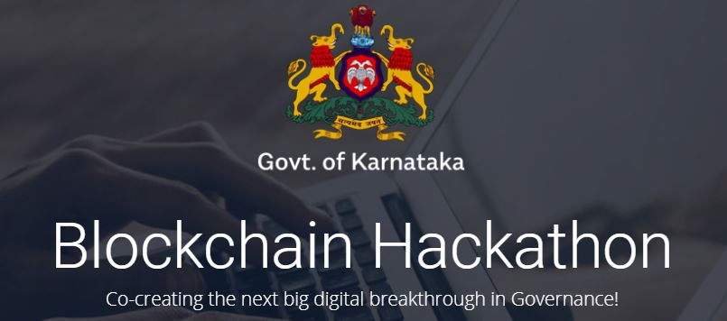
Cross Domain Multi-Stakeholder Decision Making
Team Name : The BlockBusters
Use Case : 1
Table Number : 59
Team Members:
Gagan Vasudev | Ajit Singh
Dharmesh Khandelwal | Swati

Slide 2
Problem Statement
Cross-Domain multi-stakeholder decision making
Under the Karnataka Tree Preservation Act, tree felling requires a permit. In order to apply for and obtain a permit, verification from multiple departments is involved. These include:
Location of tree on land (Verified by Survey Department).
Verification of Ownership of land (Verified by Khata copy issued by Revenue Department).
Ownership of tree (Verified by certificate from Revenue Department).
Once these are verified, the Forest Department issues a permit for Tree Felling. After the felling of the tree, another set of activities and permits have to be issued and monitored by different departments. These could include:
Permit to transport the felled tree (Issued by Forest Department).
Monitoring of the transportation (Forest Department and Police Department).
Monitoring of the vehicle in which the tree is transported (RTO).
Sawing of the logs in a sawmill or timber factory (BESCOM would monitor electricity supply, Forest Department would monitor Timber Accounting and so forth).
This is a classical example of cross-domain multi-stakeholder decision-making, which features in many interactions across government.

Slide 3
Bottlenecks in current system
We have a solution to all of this
Wastage of Time
Forest Department officials have to verify the paper documents and do spot inspection.
Wastage of Money
Doing spot inspection incurs transportation cost.
Wastage of Effort
Since the documents will be verified by each of Land, Survey and Revenue Departments every time the tree cut permit is requested by the farmer, so there is a lot of redundant activities.
Risk of Fraudulent Activities
The paper documents are prone to forgery, so there is always a risk of fraudulent activities.
Wastage of Paper
All the documents granted by each of Land, Survey and Revenue Departments are paper based, so a lot of paper is required to prepare the documents.
More Staffing Required
A lot of employees are staffed so as to verify the documents and to do spot inspection.
Quick Decisions
Since, the forest department can access the required data from the Blockchain, so there wont be any wastage of time.
No Wastage of Money
Money will be saved as there will be no spot inspections(can be done if required).
Less Effort Required
Since verified data(from Blockchain) is available to the Forest Department when it receives a permit request, so the official can easily verify the request and grant permit.
No Risk of Fraudulent Activities
No risk of fraudulent documents as the cryptographically secure data is used to verify the permit requests.
No Wastage of Paper
All the data used for verification comes from Blockchain, so paper documents are no more required.
Less Staffing Required
Less employees will be required to grant permits as less manual work is done in the newly proposed system.

Slide 4
Architecture Diagram

Slide 5
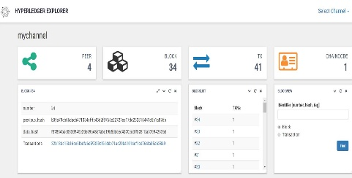




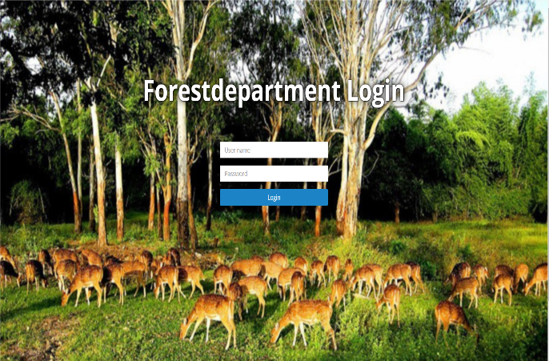
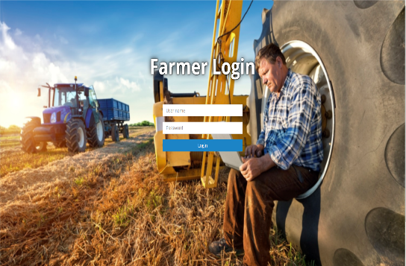






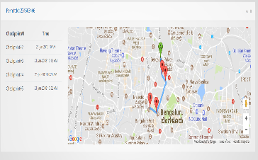

Forest Dept. Official
Farmer
Blockchain Analytics Dashboard
Pro-active messages from bot regarding status of permit
Land Dept official logs in and grants/rejects permits
Farmer logs in and requests for tree cutting permit
Information regarding transactions, blocks, peers in the Blockchain network for administrative services
Farmer
Chatbot
Forest Dept
Land Dept
Requests from webapp hit the REST server with proper authentication credentials
Revene Dept
Survey Dept
Adding transactions , executing smart contracts and retrieving access control based data
Secured REST APIs
Hyperledger Blockchain
Addition and retrieval of signed documents based on hash stored in Blockchain
RTO depart approves and monitors the route of the vehicle
RTO Dept. Official
IPFS Cluster : Distributed File System

Slide 6
Technology Stack
Blockchain
Hyperledger Fabric 1.0
Pluggable Consensus Mechanism
No use of gas for transactions
Consensus time is very less than that of Ethereum
Multichannel Communication support
Governance by Linux Foundation
Why Hyperledger over Ethereum?
IPFS (Interplanetary File System)
Used for storing the artifacts(signed pdf documents) which are generated at each step of Blockchain transaction.
The pdf documents are stored in IPFS, but the hash of these documents are stored in the Blockchain.
Back-end REST Services
Spring-boot Microservices with APIs secured via OAuth2 flow.
Deployment Strategy
Docker
The web application UI, REST API microservice and Blockchain peers run as docker containers on the cloud.
Front-end UI
Angular4 framework integrated with Google maps
Bot Framework
Microsoft Bot framework integrated with SMS gateway (Twillio)
Bot services runs as Azure Web Services

Slide 7
Features of Blockchain used in our solution
Private Channels for Data Replication
We have set up a private channel so that the respective peers share data privately.
Immutability
We can trust the data that is written in the blocks and the data should be immutable : can’t be changed or tampered or deleted.
Faster Settlement
The execution of chaincode (smart contracts) can enable the Forest Department to make quick decisions.
Distributed consensus
This enables the Blockchain to present a single version of the truth without the requirement of a central authority.
Permissioned Blockchain
The permissioned networks can be great for fraud prevention because they restrict who is allowed to participate and in what capacity.

Slide 8
Solution Demo is present in the video

Slide 9
Future Scope
Integration with Aadhaar services
When the farmer registers the land with the Land Dept, then the Aadhar number is registered with land’s unique id.
GPS tracking of the vehicle
When the commercial vehicle carries the cut tree to the saw mill, then the GPS location of the vehicle will be monitored at each checkpoints mentioned by the RTO in the route plan.
IoT enabled transport vehicles
The cut tree when loaded in the vehicle, the weight measuring sensors integrated in the truck measure the total weight of the wood and send it to the REST API so that this data be recorded in the Blockchain.
Power Consumption Monitoring by BESCOM
Taking BESCOM as another stakeholder (peer) in the Blockchain network, BESCOM can see how much power is consumed by the Saw Mills for sawing the tree wood. This will give them insights regarding power consumption and efficiency of the Saw Mills.

